Slide 1
Customer segmentation
By,
Priyadharshini.E
Keerthana.S
Dharsniritika.KG
Gayathri.B

Slide 2
content
Introduction.
Data Science Process.
Need of Data Science.
Data Collection.

Slide 3
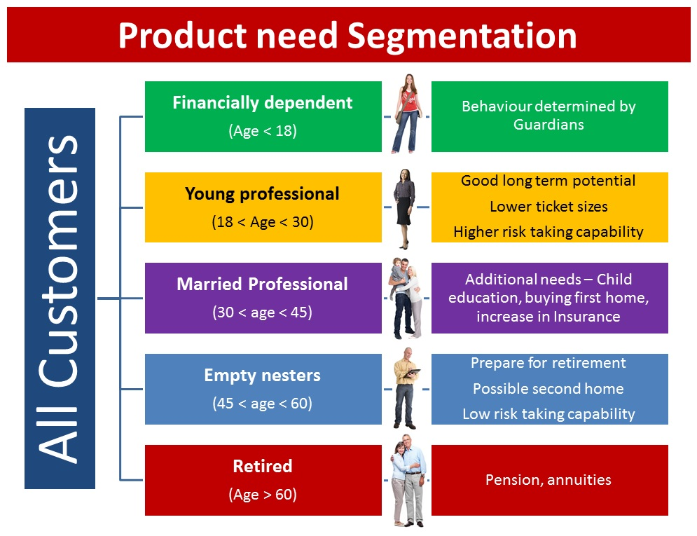
Introduction.
Customer segmentation is a marketing concept used by businesses to divide their customer base into distinct groups based on their common characteristics.
It helps companies better understand their customers and enables them to tailor marketing strategies, products, and services to meet the specific needs and preferences of each customer segment.
By analyzing customer data such as demographics, shopping behavior, and browsing history, companies can segment their customers.

Slide 4
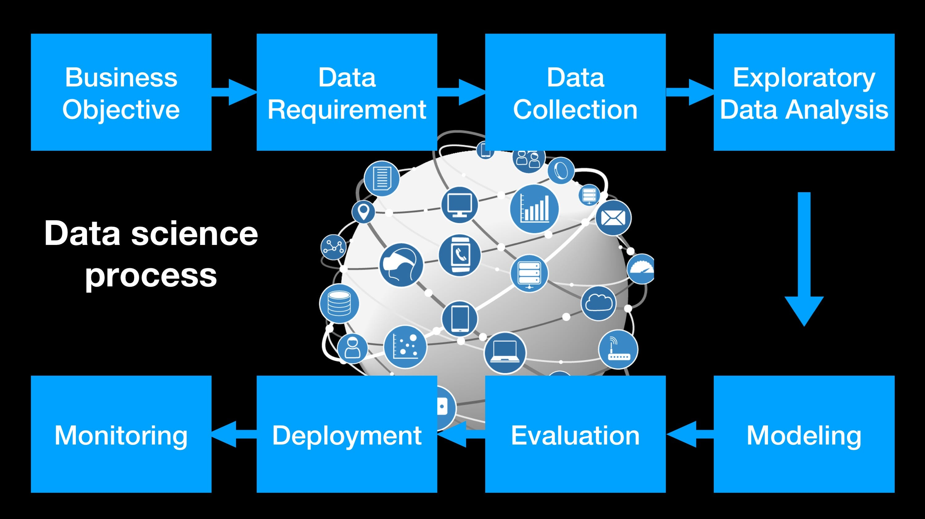

Slide 5
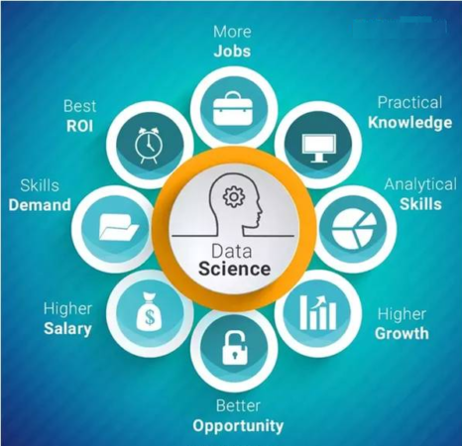
Needs of Data Science
Practical
Analytical
Higher
Better
Skills
Jobs

Slide 6

THANK YOU

